Slide 1
Comprehensive SEO Audit & Optimization for Organic Traffic Growth
Tharuna | MBE8

Slide 2


Company Selection
GOFRUGAL Technologies Pvt. Ltd
About
Gofrugal is a digital-first company offering cloud and mobile ERP solutions to Retail, Restaurant and Distribution businesses. Established in 2004, we help businesses embrace agility and transform digitally to stay competitive in the dynamic market. We help businesses grow with minimal staff, least skills along with accurate and reliable solutions. Gofrugal's products and solutions empowers businesses to delight its customers, manage them efficiently, connect and collaborate with its stakeholders and most importantly take timely decisions on the move. More than 30,000 customers across 75+ countries experience simplicity in running their businesses with Gofrugal. We address the needs of a wide spectrum of customers from small independent stores to local chains and large enterprises. A global player headquartered in Chennai, we envision a ‘Happiness First’ environment to provide a friction less experience to all the stakeholders.

Slide 3
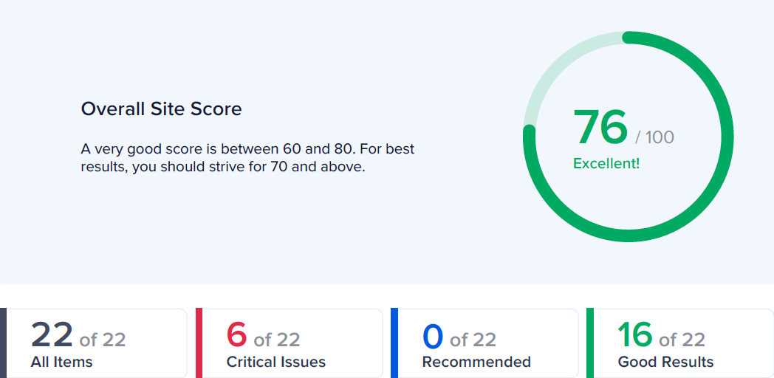
SEO Score
Critical Issues
The meta description is 269 characters long, which is too long.
Some images on the page have no alt attribute.
Too few internal links on the page.
Some Open Graph meta tags are missing.
The server is not using "expires" headers for the images.
Some Javascript files don't seem to be minified.

Slide 4
Initial Audit
Current Performance:
Overall SEO Score: The website has a strong overall SEO score of 76/100, indicating good optimization efforts.
Search Visibility: Keywords are well integrated into the title and description, improving the website's visibility in search engine results.
Page Load Speed: The website has a fast response time, under 0.2 seconds, which is crucial for user experience and search rankings.
Strengths:
Title and H1 Tags: The website uses appropriate titles and H1 tags that include keywords, enhancing SEO effectiveness.
Schema Markup: The website utilizes Schema.org data, which helps search engines understand the content better and improves visibility in search results.
Security Measures: The site uses HTTPS, ensuring secure data transfer, and has not been flagged for malware by Google.
Weaknesses:
Meta Description Length: The meta description is too long, which could negatively impact how it is displayed in search results.
Unminified Javascript Files: Some Javascript files are not minified, which can affect the site's performance and load times.
Missing Alt Attributes: Several images on the page lack alt attributes, which can harm accessibility and SEO.
Limited Internal Linking: The website has too few internal links, which can affect navigation and the distribution of link equity across pages.

Slide 5
Keyword Research
Primary Keywords:
ERP software
Retail ERP
Restaurant ERP
Distribution ERP
Long-Tail Keywords:
Affordable ERP software for small businesses
Best ERP software for restaurants in India
Cloud-based retail ERP with inventory management
To perform keyword research and competitive analysis for Gofrugal, consider the following:
Secondary Keywords:
Omnichannel ERP
Cloud-based ERP
POS systems
Inventory management software
Competitive Analysis:
Competitors: Tally, Zoho, SAP, Oracle ERP
Focus on: SEO strategies of competitors, content gaps, and keyword ranking.
This approach can help target Gofrugal’s potential customers effectively.

Slide 6
On-Page SEO Optimization Audit
Website Score: 69
Crawled Pages: 249
Indexable Pages: 1.6k
Critical Issues: 99 (e.g., internal links to 3xx pages, missing alt texts)
Warnings & Opportunities: 1k+ each (e.g., duplicate content, missing meta descriptions, and titles)
Notices: 1.6k (e.g., image optimization, broken internal links)
Key Areas for Improvement:
Links: Address internal and external link issues.
Content Relevance: Optimize headings, alt texts, and descriptions.
Security & Indexability: Fix HTTPS links and canonical tags.
Page Speed: Optimize images and reduce DOM size.
This audit highlights critical areas that need attention to improve site performance and SEO.

Slide 7
Technical SEO Analysis
Current Technical SEO Status
Website Score: 69
Page 1 (ERP Software for Retail)
Duplicate H1 tags
Long meta descriptions
Missing canonical tags
Page 2 (Restaurant ERP Software)
Canonical pointing to a noindex URL
Missing HTML lang attribute
Several pages with identical alt tags
Critical Issues
Homepage:
Missing alt texts for images
Internal links to 3xx pages
Broken jump links
Page 3 (Distribution ERP Software)
Overuse of H1 tags
Missing descriptive anchor text
Long title tags

Slide 8
5 Best Practices to Improve Site and Web Page Speed
Optimize Images: Compress and serve images in next-gen formats (e.g., WebP).
Minify CSS, JavaScript, and HTML: Reduce file sizes to improve load times.
Enable Browser Caching: Store static files locally to decrease loading times for returning visitors.
Use Content Delivery Networks (CDNs): Distribute content globally to reduce latency.
Reduce Server Response Time: Optimize server configurations and use faster hosting solutions.
These strategies will address critical technical SEO issues and improve both site speed and overall performance.

Slide 9

Content Strategy Plan
Drive organic traffic and increase conversions by targeting relevant keywords.
Keyword Focus:
Primary Keywords: ERP Software, Retail ERP, Restaurant ERP, Distribution ERP.
Secondary Keywords: Cloud ERP, Omnichannel ERP, Inventory Management Software.
Long-Tail Keywords: Affordable ERP for Small Businesses, Best ERP for Restaurants, Cloud-Based Retail ERP.
Content Creation:
Blog Posts: Write in-depth articles on ERP solutions for various industries, emphasizing pain points and solutions.
Case Studies: Showcase successful implementations of Gofrugal’s ERP solutions.
Guides: Develop downloadable guides on selecting the right ERP software.
Video Content: Create explainer videos and customer testimonials.
Content Distribution:
Social Media: Share blog posts, guides, and videos across LinkedIn, Twitter, and Facebook.
Email Newsletters: Promote new content to subscribers.
SEO Optimization: Regularly update content with new keywords and trends.

Slide 10
Off-Page SEO Plan and Strategy
1. Link Building:
Guest Blogging: Contribute articles to industry-related websites with backlinks to Gofrugal’s site.
Partner with Industry Influencers: Collaborate with influencers to create content and backlinks.
Directory Listings: Submit the website to relevant business directories (e.g., Capterra, G2).
2. Social Media Engagement:
Regular Posting: Share content on LinkedIn, Twitter, and Facebook.
Engage with Industry Groups: Participate in discussions on LinkedIn groups and forums.
Promote Content: Use paid promotions on social media to reach a broader audience.
3. Online Reviews and Reputation Management:
Encourage Customer Reviews: Request reviews on platforms like Google My Business and Capterra.
Monitor Brand Mentions: Use tools like Google Alerts to track and respond to brand mentions.

Slide 11
4. Influencer Outreach:
Identify Key Industry Influencers: Engage them in sharing or reviewing your content.
Collaborations: Partner for webinars, podcasts, or joint content pieces.
5. Content Syndication:
Syndicate Blog Posts: Share content on platforms like Medium, LinkedIn Pulse, and industry-specific forums.
Repurpose Content: Convert blog posts into infographics, videos, or podcasts to share across various channels.
This combined content and off-page SEO strategy will enhance Gofrugal's online visibility, drive traffic, and improve search engine rankings.

Slide 12



